Slide 1
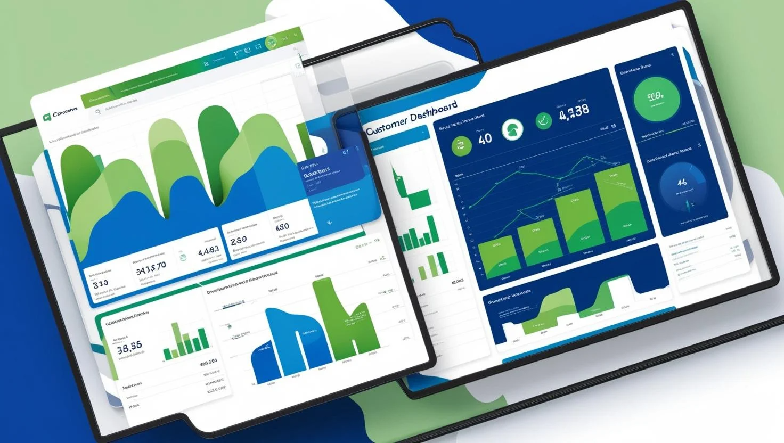
Customer Churn Prediction
Data-Driven Retention Strategy
Presented By :
Rejin CR
28-03-2025

Slide 2

The Churn Crisis)
Business Problem
Problem:
"16.84% of customers churned yearly → $1.463B lost revenue.“
Key constraints:
⚖️ "Class imbalance (1:5 ratio)“
❌ "False negatives cost 5x more than false alarms“
Objective :
"Maximize Recall to identify ≥90% of potential churners
for proactive retention"

Slide 3

Our Data Journey
Data Cleaning
🧹
Data Exploration
📊
Feature Engineering
✂️
Model Deployment
🚀
Train-Test Split
🎯
Model Workflow
Model Evaluation
📈
Scaling & Encoding
✨
Model Tuning
⚙️
Model Training
🤖
SMOTE Resampling
⚖️

Slide 4
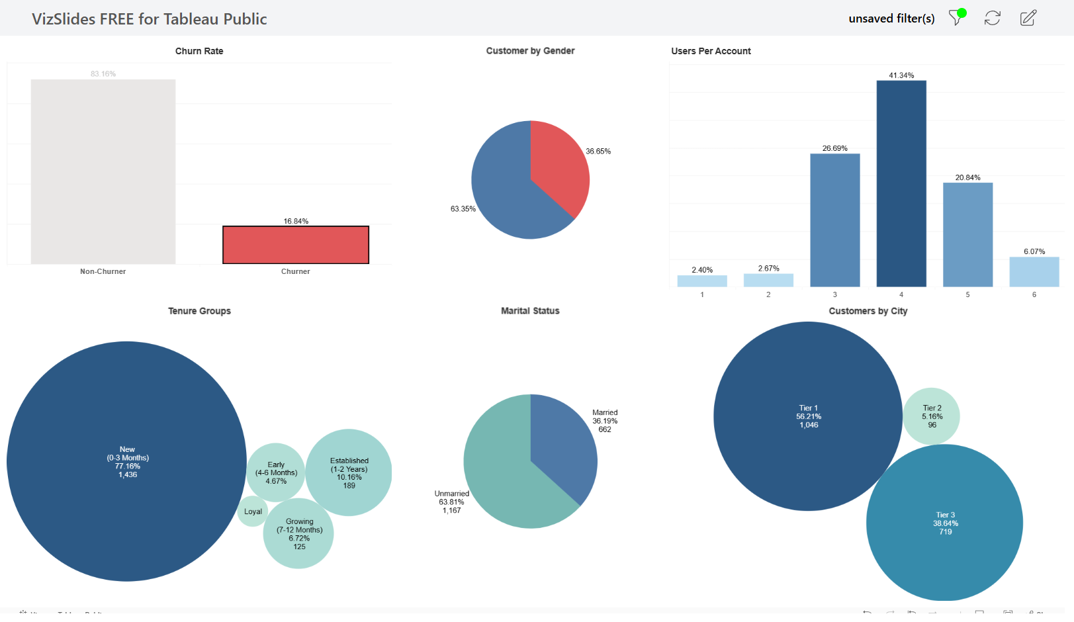
Analytical Focus
Demographic Trends

Slide 5
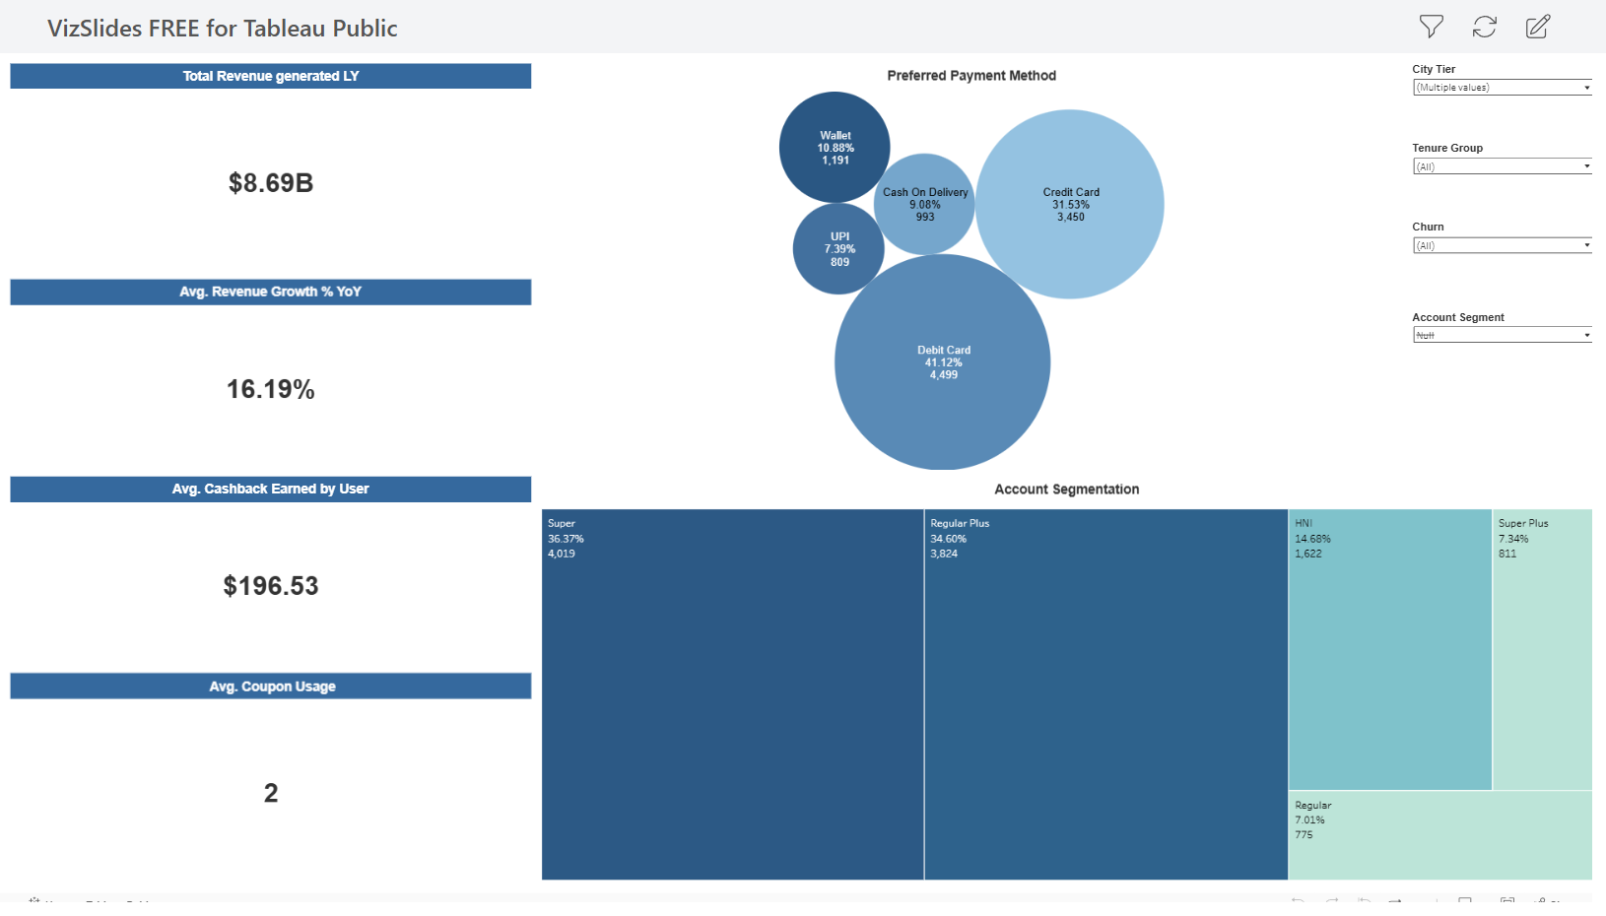
Analytical Focus
Behavioural Risk Factors

Slide 6
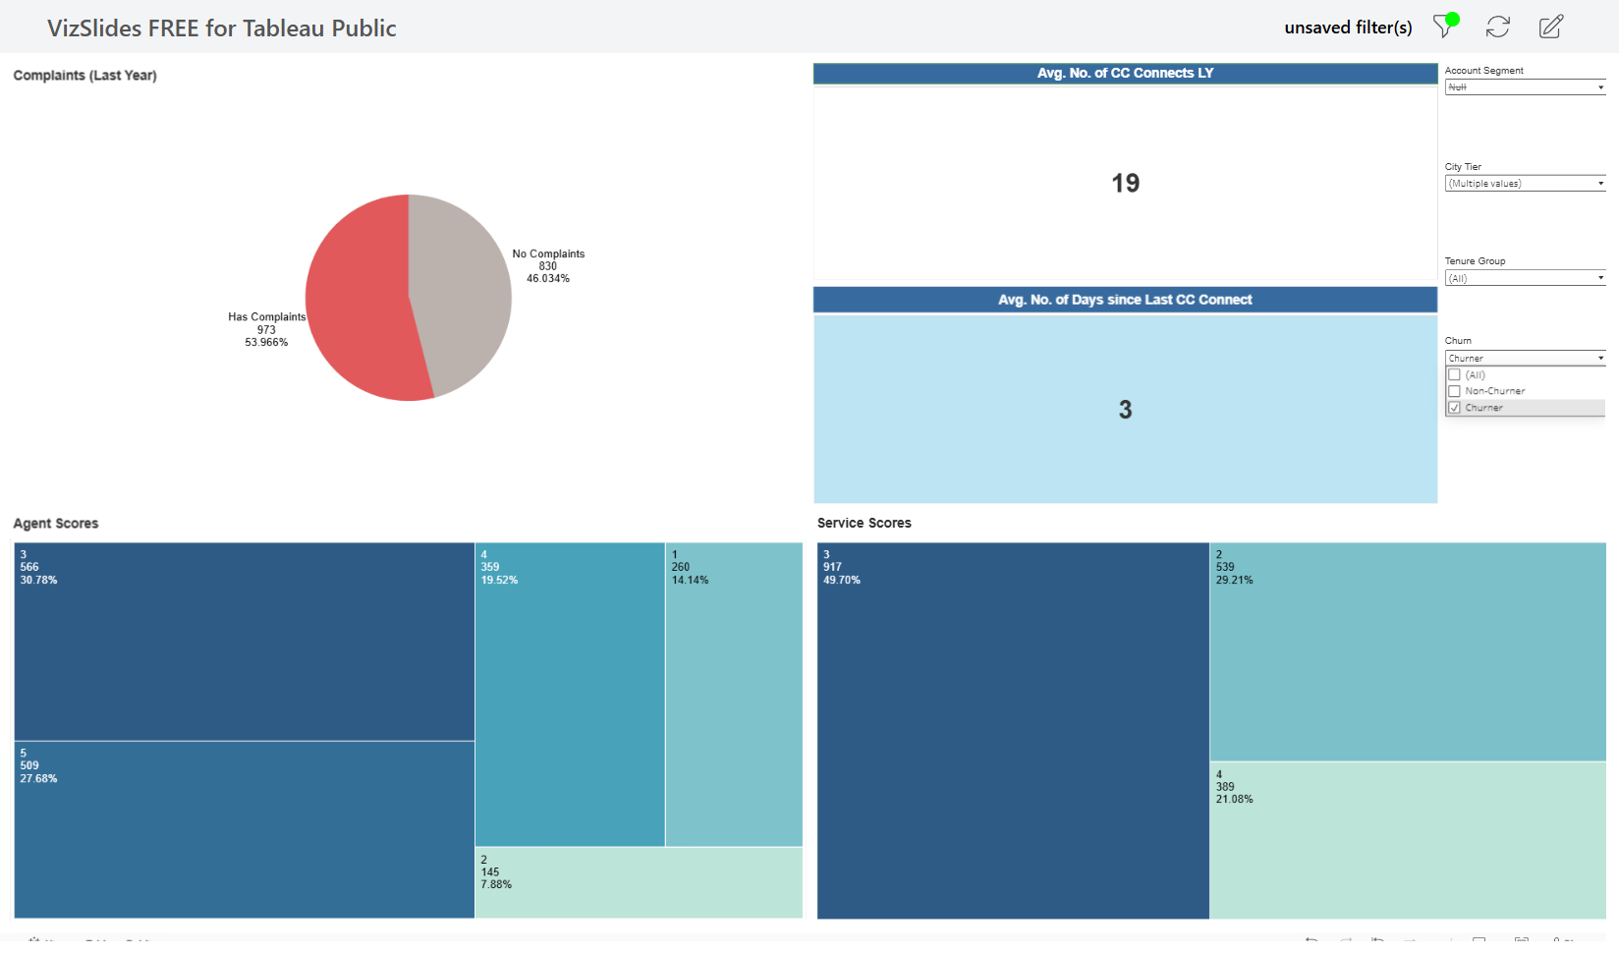
Analytical Focus
Complaints & Revenue Leakage

Slide 7
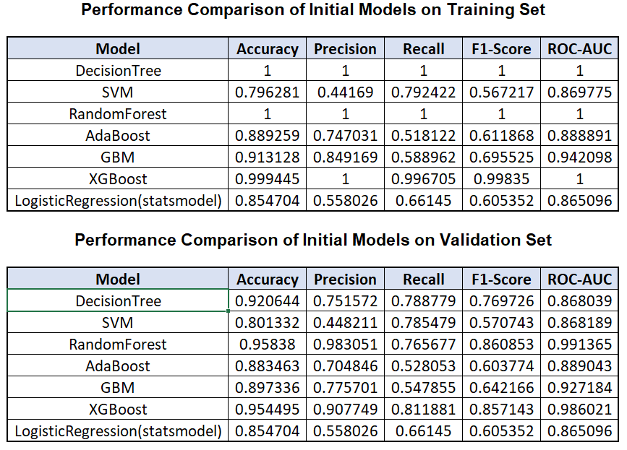
)Model Showdown

Slide 8
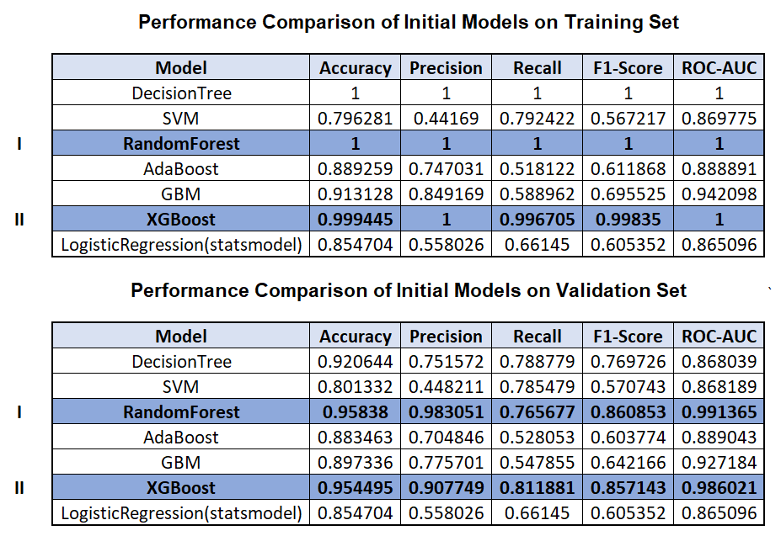
)Model Showdown

Slide 9
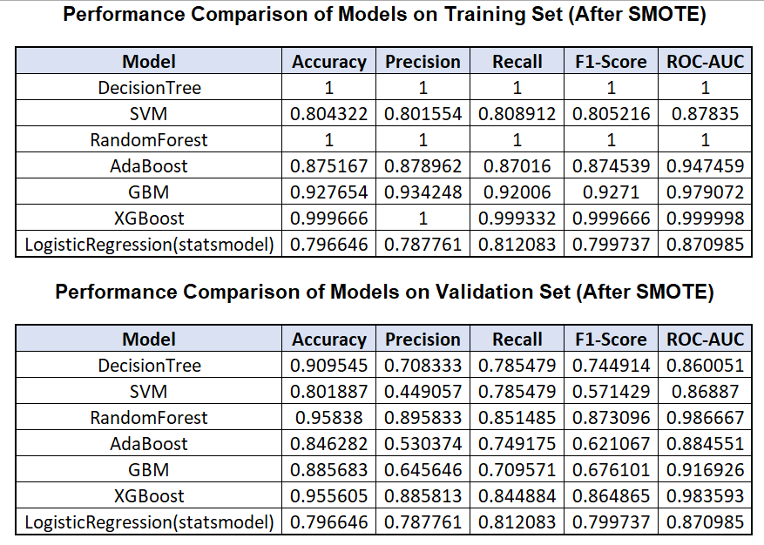
)Model Showdown

Slide 10
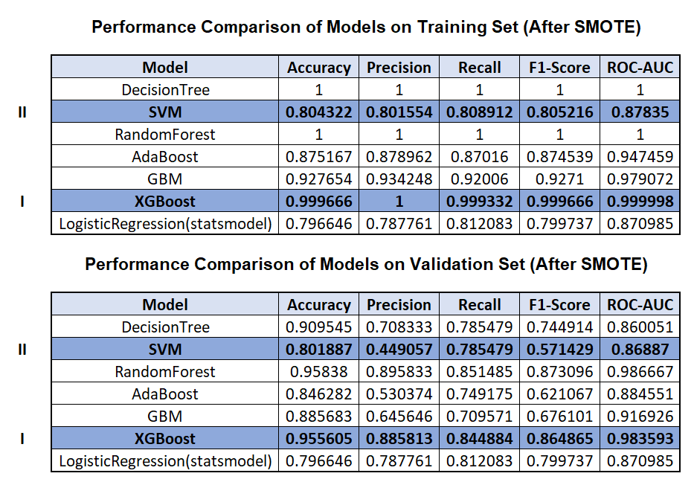
)Model Showdown

Slide 11
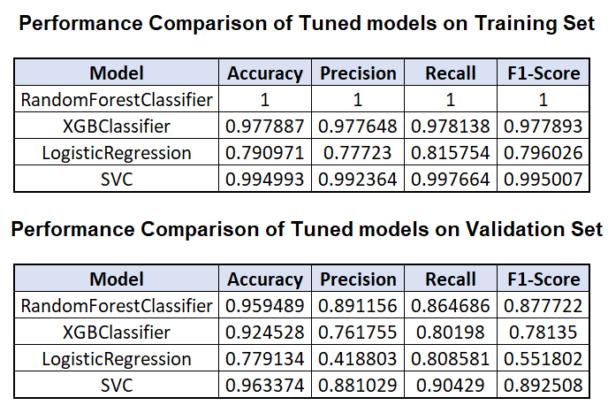
)Model Showdown

Slide 12
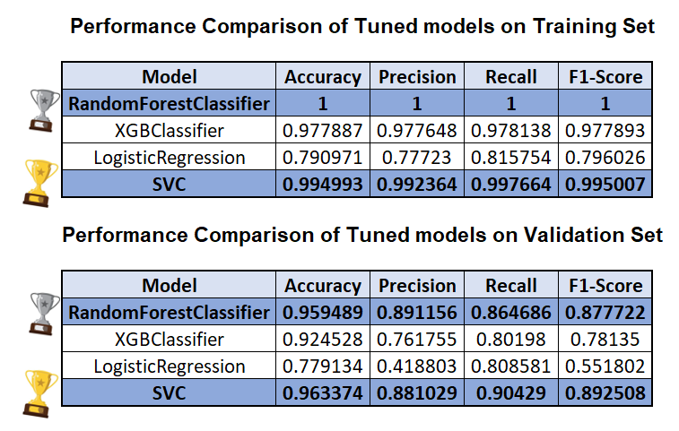
)Model Showdown

Slide 13
)Model Showdown
Best Model: SVC
Highest Recall on Validation Set: 0.90429
Balanced Performance: Strong precision (0.881) and F1-score (0.893)
Generalization: Small gap between training (0.998) and validation (0.904) recall, suggesting minimal overfitting.
Backup Model: RandomForest
Second-Highest Recall: 0.864686 (better than XGBoost and LogisticRegression).
Robustness: Handles non-linear patterns well and less prone to overfitting than XGBoost (validation recall drop: 0.978 → 0.802).
Interpretability: Provides feature importance for business insights.

Slide 14

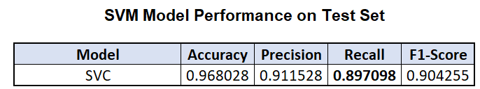
)Why SVC Won
Technical Edge
Best at capturing true churners Recall on Validation Set: 0.90429
Strong Precision and F1-score indicating fewer false alarms.
Strong precision (0.881) and F1-score (0.893)
Best Generalization and minimal overfitting.
Highest Accuracy (0.963374)
Minimal Difference b/w Train and Val scores(0.089)

Slide 15
)Churn Red Flags
Top Features

Slide 16
Action Plan
Recommendations
🚀 "Now" (Quick Wins, High Impact)
1.Launch a "First 90 Days" Retention Program
Target: Short-tenure customers (<6 months).
Actions: - Send personalized welcome kits. - Offer a "loyalty bonus" (e.g., 10% cashback after 3 months).
2. 24-Hour Complaint Resolution Pledge
Assign a rapid-response team to address complaints flagged in the last year.
Track resolution time and customer satisfaction post-fix.
3. Boost CC Agent Performance
Implement weekly training sessions focused on low-scoring agents (scores ≤2).
Tie bonuses to customer satisfaction metrics.

Slide 17
Action Plan
Recommendations
⏳ "Next" (Mid-Term, Strategic)
1. Personalized Campaigns for High-Risk Segments
Target: Single males in Tier 1 cities.
Actions: - Curate gender-specific offers (e.g., "Exclusive Male-Only Discounts"). - Partner with local influencers for hyper-local engagement.
2. Payment Method Optimization
Phase out COD for high-churn segments; incentivize UPI/Wallet use with 1% cashback.
3. Predictive Churn Alerts
Integrate model insights into CRM to flag at-risk customers (e.g., low loyalty score + recent complaint).
Auto-trigger retention offers (e.g., "We miss you! Here’s 15% off").

Slide 18
Action Plan
Recommendations
🔮 "Future" (Long-Term, Scalable)
1. Dynamic Pricing
Adjust discounts/rewards in real-time based on churn probability.
2. Gamified Loyalty Program
Launch tiered rewards (e.g., "Gold Tier" for consistent spenders) with non-monetary perks (early access, VIP support).
3. City-Tier Service Hubs
Open localized support centers in Tier 1 cities to address geographic churn drivers.

Slide 19
Q&A Ready
Your Questions

Slide 20
Thank You

